Slide 1
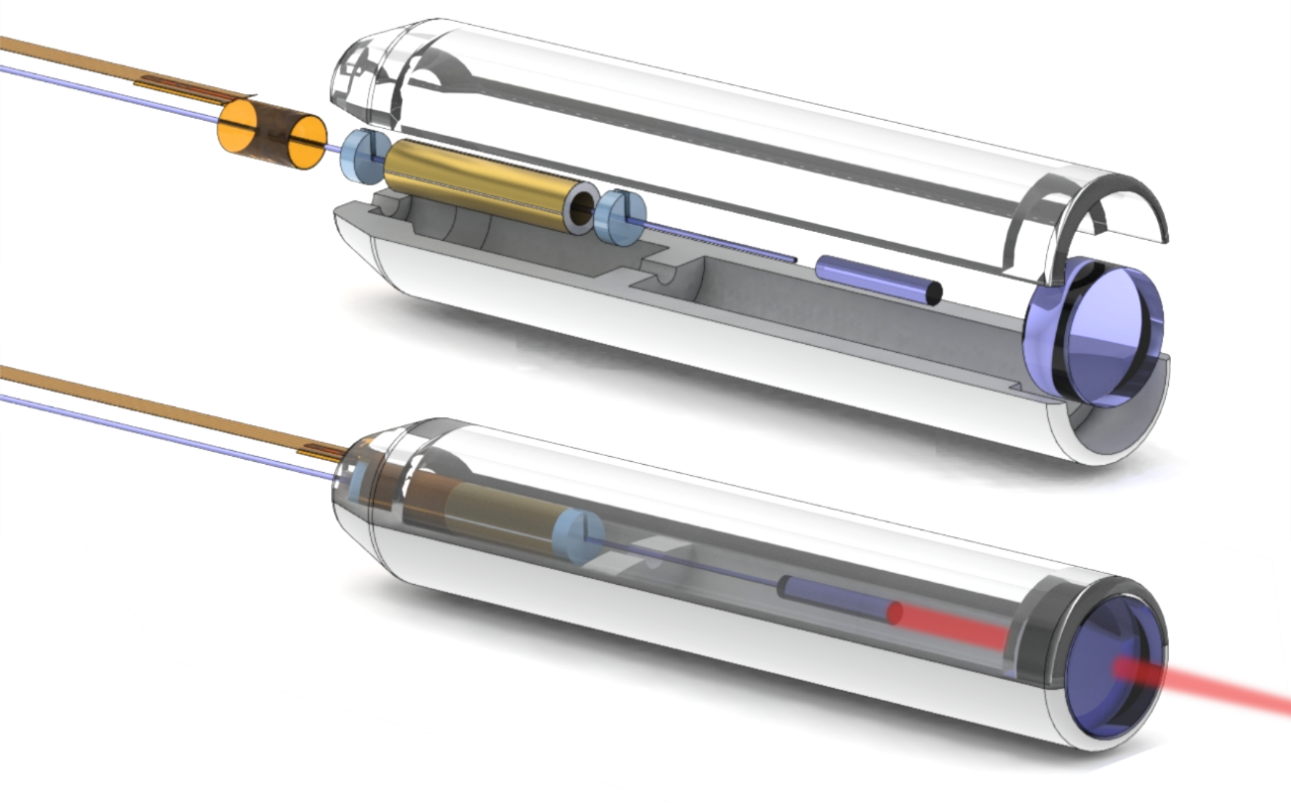
Compact OCT scanner for a bimodal endoscopic probe
Sergio Vilches
Notes:
Motivation: multimodal probe

Slide 2
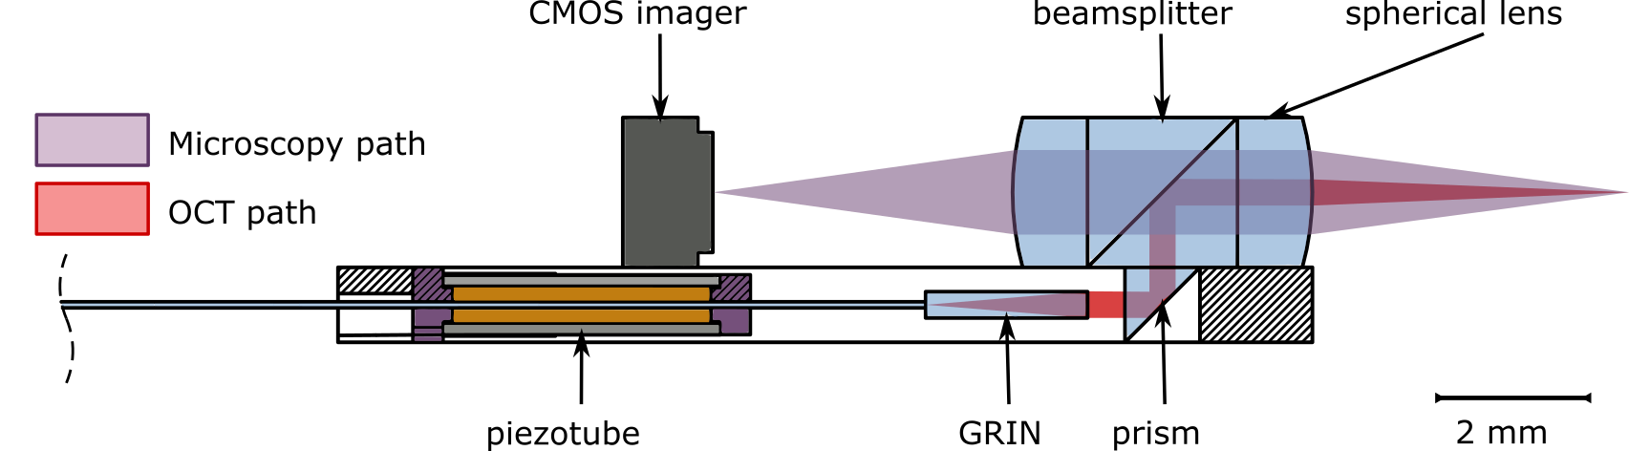

Slide 3
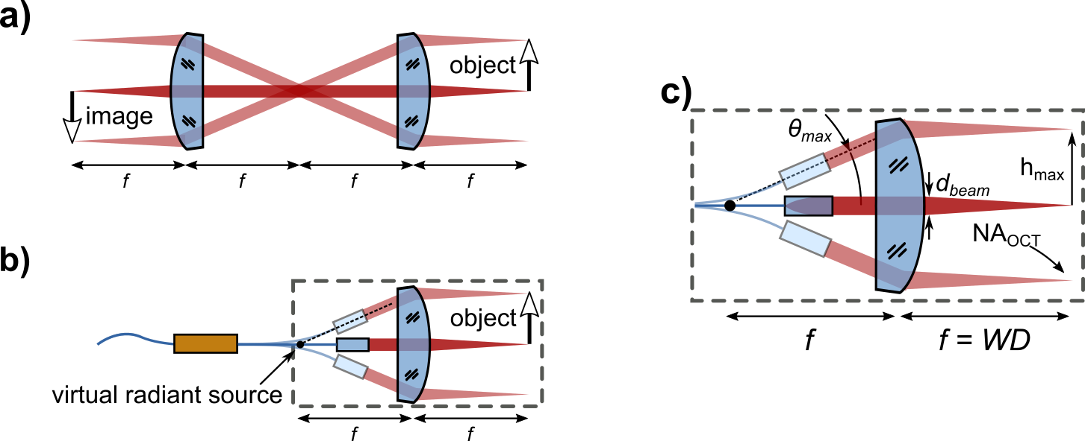

Slide 4
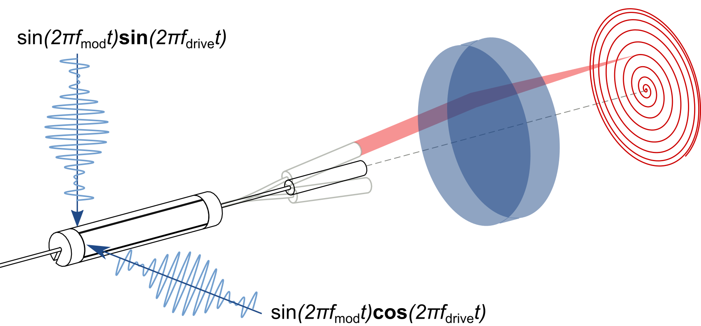

Slide 5
